Slide 1

Data Centers and Nuclear Power on the Susquehanna River: More Questions than Answers.

Slide 2
Unanswered Data Center Issues
Data centers – unlike residential and business customers — require a consistent and steady supply of electricity 24 hours a day, seven days a week.
There are a number of issues that have not been addressed or fully flushed out; and, there are also several questions of paramount importance relating to AI and nuclear power.

Slide 3
What is the priority: Computers or humans?
Do the needs of Big Tech outweigh public benefit?
Will the data center be co-located or in-front of the meter?
At what point — if any – does the public have an opportunity to be part of the process and establish priorities?
How will the consumption of a large quantity of water for data centers and nuclear plants which operate 24/7 impact water supplies for farms, families, and small businesses?

Slide 4
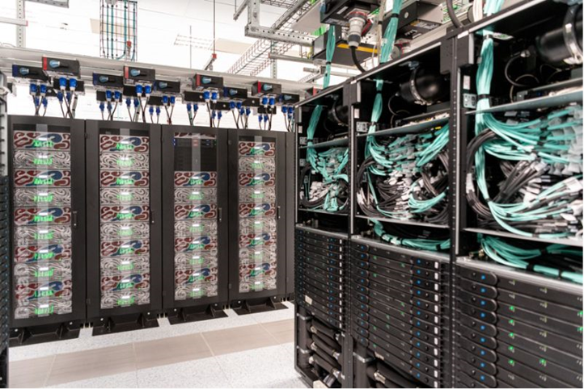

Slide 5
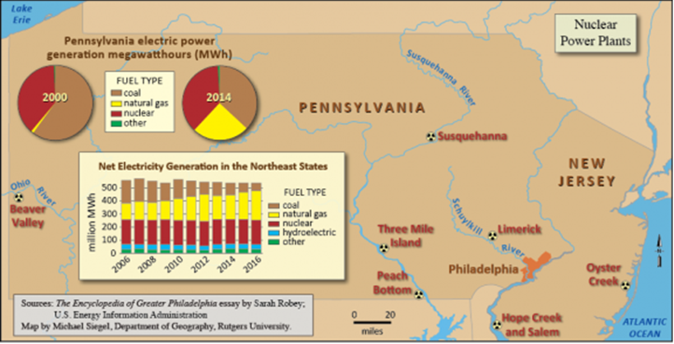
Pennsylvania has the second highest concentration of nuclear power plants in the nation. The fleeT consists of four plants and 8 generating stations which generate 32% of Pennsylvania’s power or 40,966 MW during the summer peak period.

Slide 6
Refueling
Nuclear power plants must refuel every two years from 30 to 45 days for refueling. This raises the questions of where do Amazon and Microsoft get their energy when nuclear plants are down
Nuclear power plants get replacement energy during refueling—which usually occurs every 18 to 24 months—primarily from natural gas, coal, and sometimes increased output from other nuclear units.

Slide 7
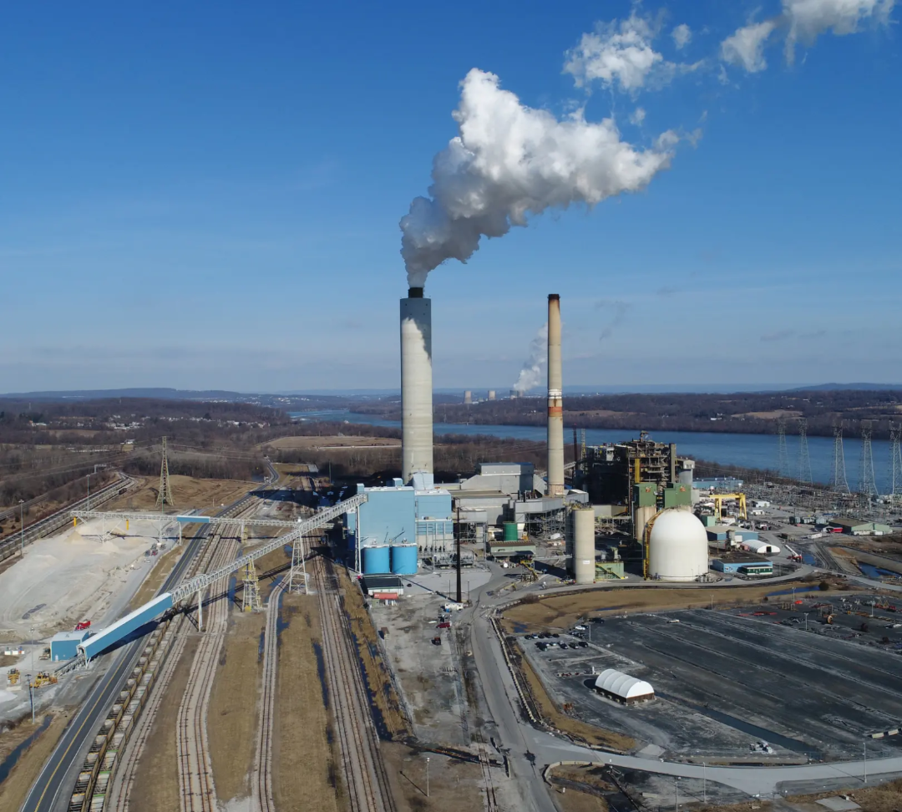

Slide 8
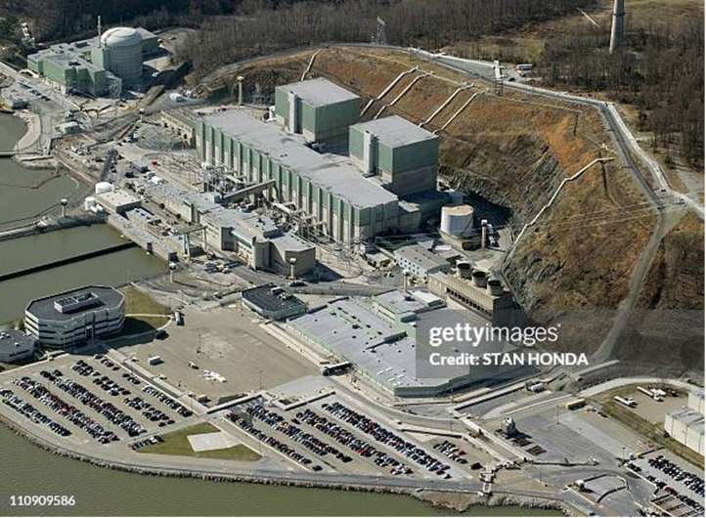
Peach Bottom
The Peach Bottom Atomic Power Station is the only nuclear plant on the Susquehanna River not married to a data center. Peach Bottom is owned by Constellation Energy and Public Service Enterprise Group. Both entities own 50% of Peach Bottom and Constellation is the site operator.
The plant can withdraw over 1.5 million gpM, or approximately 2.16 billion gallons per day, for its condenser cooling system.

Slide 9
Susquehanna Steam Station
The Susquehanna Steam Electric Station (“SSES”) is located in Luzerne County; and, the total cost in 2007 dollars was $7.983 billion. The area includes the anthracite coal region. PPL operated the plant until June, 2015 when Talen Energy was spun off from PPL's competitive supply business. Talen entered bankruptcy in 2022, and emerged from it in 2024.

Slide 10
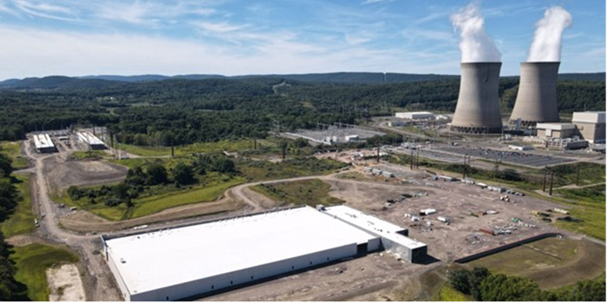
Ownership and Consumption
Talen Energy owns 90% of Susquehanna Electric Steam Station and is the site operator. The Allegheny Cooperative owns the remaining 10% of the nuclear station. The SSES has a capacity of 2,476 megawatts.
One half of SSES’s electricity will be consumed by Amazon in 2032.

Slide 11

Three Mile Island Unit-1 (“TMI-1”) is an 835 MW pressurized water reactor designed by Babcock and Wilcox. The initial construction cost for TMI-1 was $400 million or $2.55 billion in 2018 dollars. TMI-1 wants permission to use 73 million gallons of water a day.
Microsoft reportedly entered into an agreement where they would buy all the electricity the 835-megawatt TMI Unit-1 would generate over 20 years. That energy is for one client with locations in the Midwest and Virginia. This plant will not create additional baseload.

Slide 12
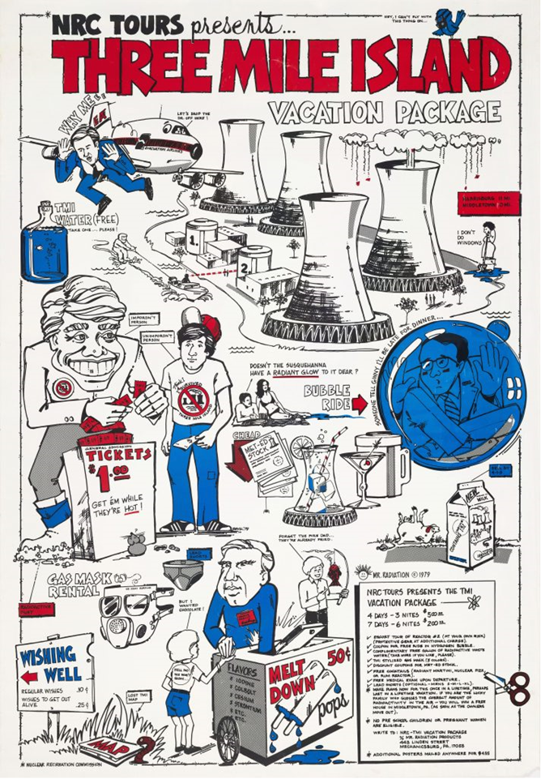
Three Mile Radioactive Vacation

Slide 13
How to Meet the INcrease in Power Demand?
The growth in power demand driven by the rise of artificial intelligence and cloud computing is currently being met by dispatchable fuel, i.e., coal, gas, and nuclear power. Pennsylvania is resource rich. Energy and water capacity exceed demand, but are Also Exported. Pennsylvania is expected to ramp up capacity to shoulder the energy and water needs of data centers.

Slide 14
The Marcellus Shale boom led people to believe gas was the answer. Pennsylvania produces a significant amount of natural gas, ranking second in the nation after Texas, and in 2023 Pennsylvania's natural production reached almost 7.6 trillion cubic feet. In 2024 Pennsylvania exported an estimated 87 million megawatt-hours of electricity; thus, this makes the Commonwealth the largest net exporter of electricity in the nation.
Is Natural Gas the Answer?

Slide 15
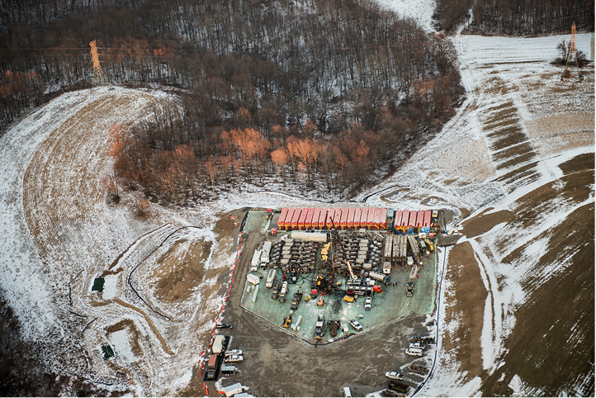
KIll, Baby, Kill!

Slide 16
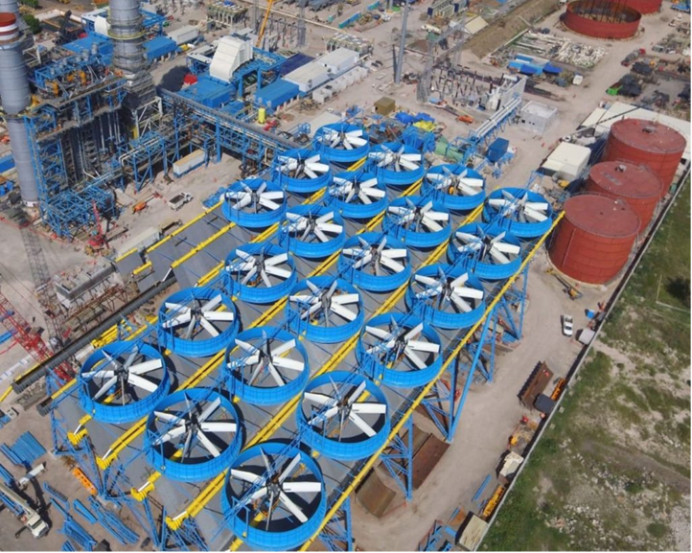
Fracking Sites
There are four fracking facilities on the Susquehanna River using dry cooling technology

Slide 17
King Coal Is Dead! Long Live the King!
More extensions for retiring coal plants and expansions for operating mines are being planned. A 1,400-acre expansion to a 2,800-acre underground coal mine beneath the Pennsylvania Turnpike in Westmoreland County has been approved.

Slide 18
Brunner Island
Three Mile Island’s neighbor, Brunner Island, has three units with dual fuel switching capabilities allowing it to operate using coal or natural gas. The plant opened in 1961, and the combined capacity of the three units is 1,546 megawatts. Brunner Island is twice the size of TMI-1, and is set to cease burning coal by the end of 2028. The plant withdraws from the Susquehanna and later discharges up to 795 million gallons of once-through condenser cooling water each day. (Lower Susquehanna Riverkeeper.)

Slide 19

Breaker Boys

Slide 20
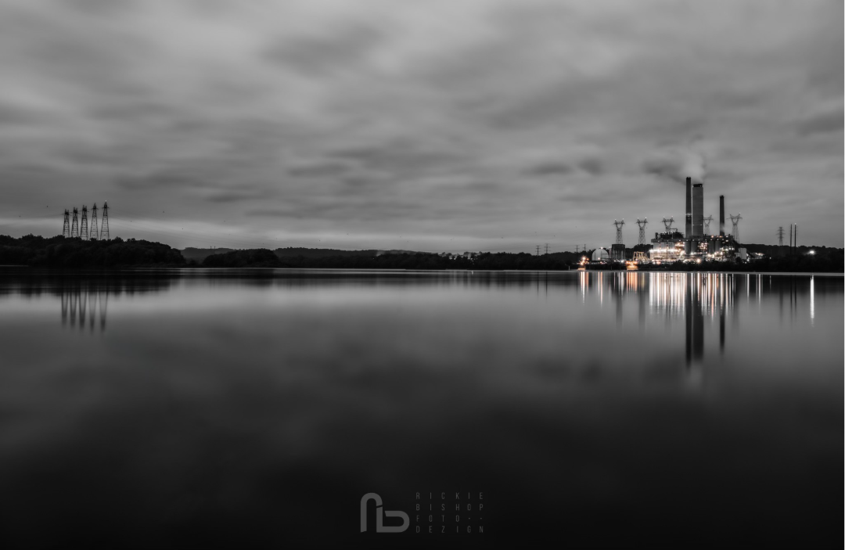
Three Mile Island’s Neighbor
What if a data center and Brunner Island cut a deal? It is unlikely PJM would oppose a coal and gas-powered data center.

Slide 21
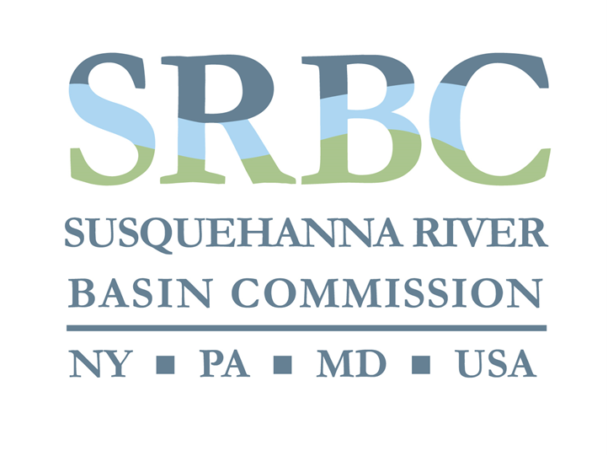
Data centers are not incentivized to conserve energy or invest in energy efficiency programs. They cannot participate in load shifting or rolling brown outs because they needed to be open 24/7.
Dry Cooling: Key Incentives & Benefits
Faster Permitting.
Flexible Siting.
Reduced Fees.
Permitting Exemptions.

Slide 22
Water: Too Cheap to Meter?
Data centers married to nuclear plants are a water consumption juggernaut. The average data center uses one million to five million gallons of water per day, equivalent to the daily water use of a town with a population of 10,000 to 50,000 residents, according to a study by Frederick County, Maryland.

Slide 23
Prime Example of Surging Demand
A prime example of the scale of water consumption is the Susquehanna Steam Electric Station (“SSES”) located in Luzerne County. When Susquehanna Steam Electric Station came on-line in 1983, its original application for water consumption was 40 million gallons per day (“mgd”). Since then, uprates and demand have impacted water use. Talon Energy Received permission for renewal of surface water withdrawal of up to 76.000 mgd from the Susquehanna River, consumptive use of up to 53.000 mgd.

Slide 24
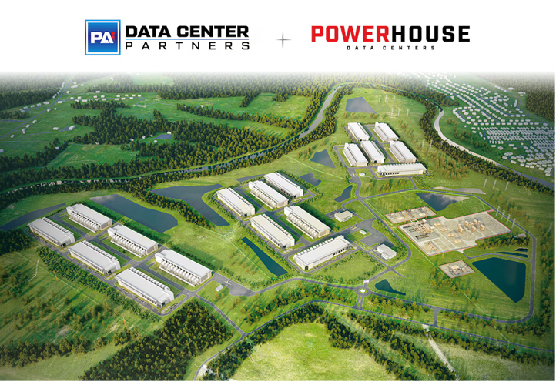
Dry Cooling Benefits
The SRBC issued a policy statement in the summer of 2024 in support of dry cooling. This strategy uses air rather than water to remove heat from a system. Dry cooling has the additional advantages of minimizing water consumption, and eliminates many of the adverse environmental problems associated with a conventional wet cooling system. Dry cooling has been adopted by four fracking facilities on the Susquehanna River.

Slide 25
Nei Dry cooling Stance
The Nuclear Energy Institute opposed the adoption of the dry cooling proposal arguing it was less efficient and more expensive.
TMI-Alert testified in support of dry cooling as an alternative to large consumptive and surface water use at nuclear plants. TMIA stated this was a more environmentally friendly option, and allowed for small businesses, farming and public health.

Slide 26
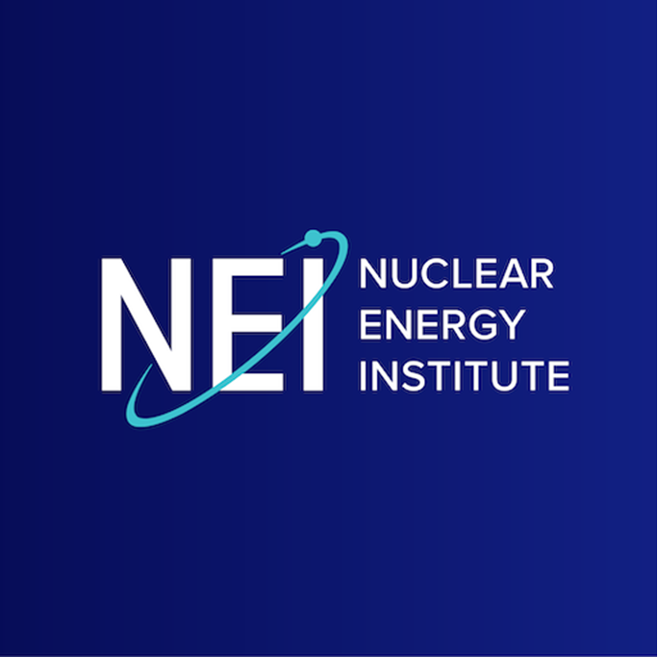
TMI-1 Test Case
The first major test of this policy is the restart Three Mile Island Unit-1. The broader question is when will there be a public policy discussion on water allocation and water equity?

Slide 27
Data Centers and FERC
Amazon Web Services (“AWS”) acquired a data center campus from Talen Energy that is co-located with the Susquehanna nuclear power plant in Pennsylvania. The data center is situated on the same property as the power plant, and is designed to be directly powered by the nuclear plant's output. However, the co-location arrangement has faced some challenges and is currently in dispute with PJM Interconnection, a regional grid operator.

Slide 28
Reliability and Costs
Members of the Federal Energy Regulatory Commission have voiced concern about how the Amazon data center, which diverts electricity from the broader grid, might affect power reliability and costs for the general public. Regardless, Amazon has a one-time option to cap its commitment at 480 MW. Talen has reached an Agreement to Sell 1.920 MGW Amazon by 2032.

Slide 29
Conclusion
The growth rate for electricity demand is likely to increase, and largely driven by data centers. However, access to water resources will impact siting, and the hyper scale centers – like Amazon - are going to require more land than earlier data centers.
Pennsylvania has approximately 77 data centers operated by 43 operators across 12 markets.

Slide 30
Amazon's Data Center
Encourage dry cooling for additional water consumption requests.
Monitor and provide records of water temperature at the point of discharge.
Provide renewable energy as backup power when the SSES is shut down for refueling.
Implement Amazon’s “water replenishment” by monitoring and protecting wetlands,and by establishing conservation easements in sensitive areas.

Slide 31
Data Center Expansion
There are waves of data centers on the horizon, and they will need a lot of power and water. What if data centers don’t expand at the rate predicted? What if retirements are delayed, and don’t outpace the construction of new resources?
The role of dispatchable fuel sources, (coal, gas, and nuclear) especially natural gas, will play a large role. Natural gas currently accounts for 26 percent of the electricity consumed by data centers, with nuclear energy holding a 15 percent share.

Slide 32
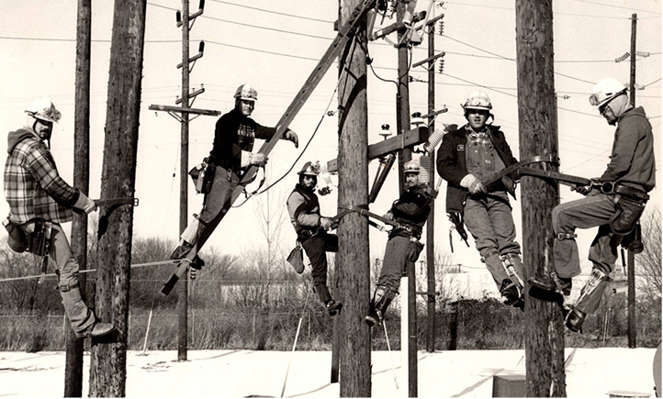
Distribution and Resiliency
Distribution and resiliency for the generation of AI will require more resilient transmission capacity. Data centers connect at much higher transmission voltages, and they require heavier duty wires than typical electric users

Slide 33
Questions for Data Center Development
Data centers and nuclear plants are not isolated from macro- economics. Dispatchable energy and renewable energy schedules will have to compete and contend with commodity prices, tariffs, and supply chain delays.
What about the consumer? What are the opportunity costs?
Should exclusive contracts between data centers and nuclear power plants be prioritized over public service?

Slide 34
Difficult Problems for Data Center Development
New projects and new rules will alter the balance of power. Nothing runs 24/7/365. A diverse range of energy and fuel sources will be necessary to meet demand. There is no cure all. The old way of doing business has to be supplanted by better coordination and oversight, clear and consistent standards and regulations, and equal opportunities to access the grid for all energy sources.

Slide 35
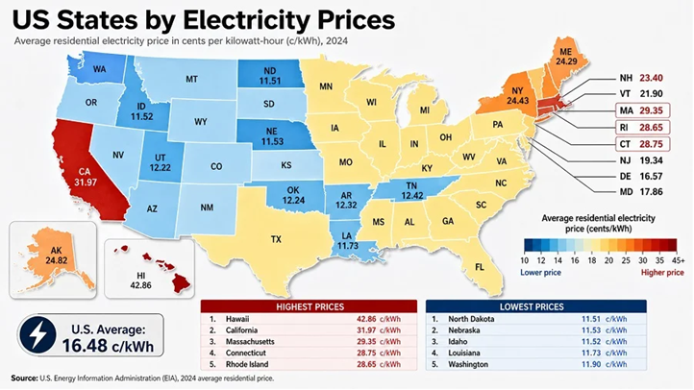
Electricity Prices

Slide 36
Data Center Expensive Marriage to Nuclear Power
The marriage of data centers to nuclear power is an expensive proposition. Nothing is cheap, and nothing is certain. Nothing runs all the time.
The partnership between data centers and nuclear power plants has the potential to supply a portion of the demand for data centers, but does nothing to address the energy needs of businesses, consumers, and farmers.
When it comes to data centers and nuclear power plants hooking-up: The glass is neither half full or half-empty. It’s expensive and opaque.

Slide 37

Data Center FUture Paradise or Disaster?

