Slide 1
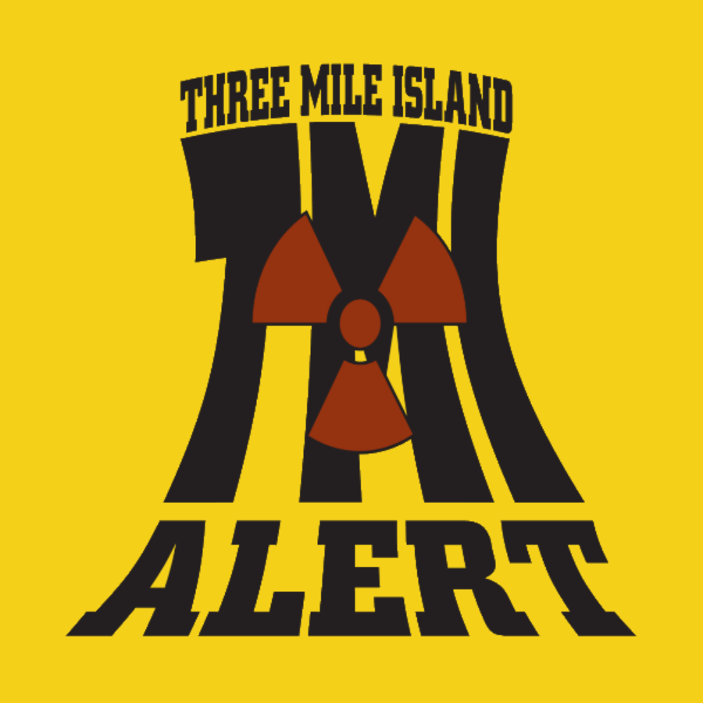
Three Mile Island: The Accident Without End

Slide 2
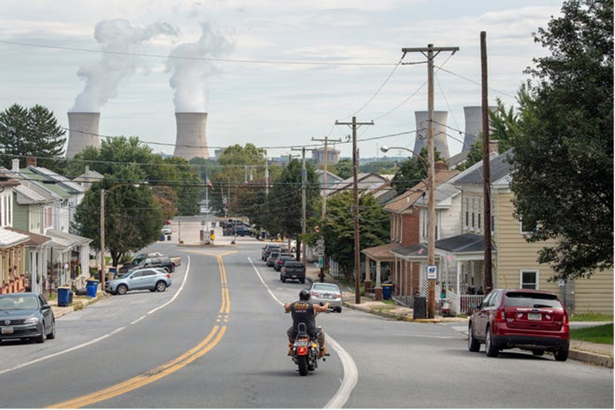
Restart
The proposed restart of Three Mile Island Unit-1 was met with unabashed enthusiasm by Governor Shapiro and the legislature.
The deal was cooked up in the dark in board rooms and political parlors. Three Mile Island will have one client: Microsoft. The marriage between Microsoft and a zombie nuclear plant is exclusive, and benefits Amazon’s facilities in Chicago, Virginia, and Ohio.

Slide 3
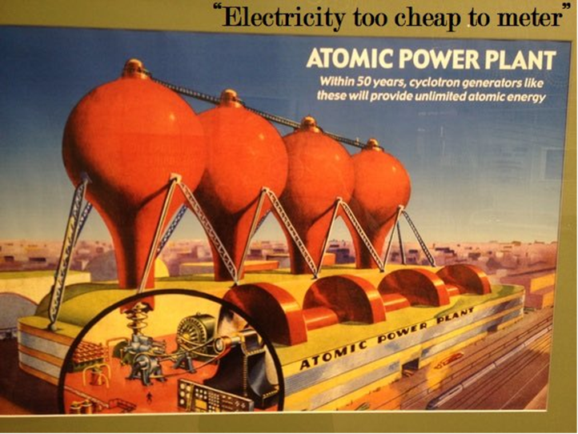
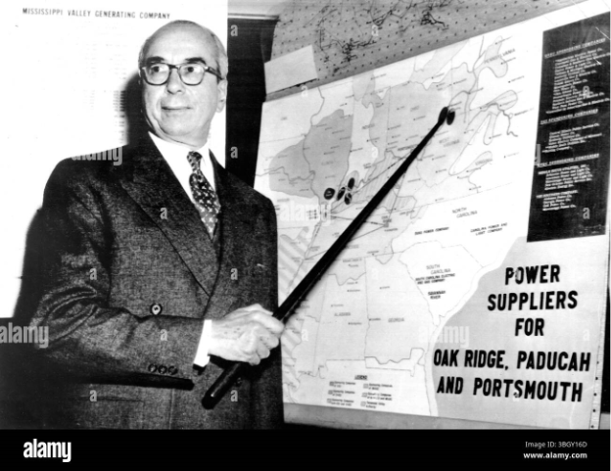
Sometimes you have to revisit the past to rescue the future. In the 1960s atomic scientists predicted the dawn of a new day where automobiles would be powered by nuclear fuel, and weather could be controlled by atomic clouds. Their high priest - Levi Strauss - promoted nuclear energy in 1954 as "electricity too cheap to meter.”

Slide 4


Bill Gates is technology’s high priest, and founded, Terra Power, a nuclear development company. However, Microsoft did not buy energy for his proposed reactor in Wyoming. Instead, Microsoft signed a sweet heart deal TMI, that’s short on details by high on subsidies.

Slide 5


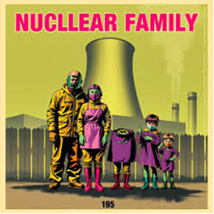
Repeating History
History does repeat itself. TMI-1 came on line in 1974, and was born out of atomic wonder lust. TMI-1’s proposed resurrection will be foisted on the backs of rate payers and taxpayers.

Slide 6
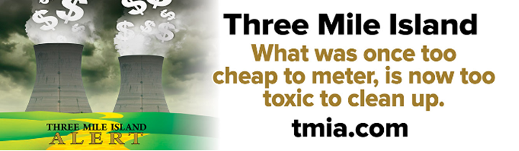
PUBLIC BAILOUT
Remember, TMI-1 was built with rate payer dollars, and enjoyed a bailout to transition to deregulation.
TMI complained they couldn’t compete in the market place. They were right. TMI-1 lost $300 million over eight years, and
the free market closed the plant in 2019.
How many times are we going to bail out TMI?

Slide 7

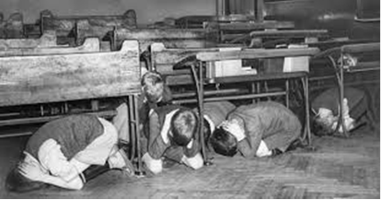
The folks who paid to build the plant, will not receive the
benefits of a restart. They will not be able to purchase homeowners’
insurance in the event of another accident. The Price Anderson Act
is a taxpayer supported insurance program for Constellation.
If nuclear is so safe, why can’t community residents get insurance to protect their family, farm, and property?

Slide 8
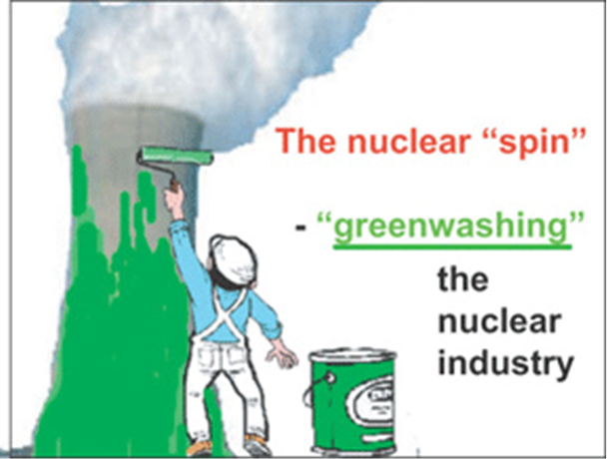
Clean and Green?
Consumers, taxpayers, and citizens have been told that nuclear power deserves a second chance because it is now environmentally friendly, because it’s not coal, and because without nuclear, the lights will go out on cold, windless nights.
How does exporting TMI-1’s energy to an exclusive client in another zip code keep the lights on in central Pennsylvania?

Slide 9

Electricity For Now Waste FOREVER
Folks need to be aware of fear mongering, and weigh the great Faustian bargain: Electricity for a moment, and radioactive waste forever.
Radioactive waste packaged in green gift wrapping in no less lethal. Three Mile Island is a high-level radioactive waste site, but
it is out of room. There are 700 tons of high-level radioactive garbage stored in the Independent Spent Storage Facility Installation.

Slide 10
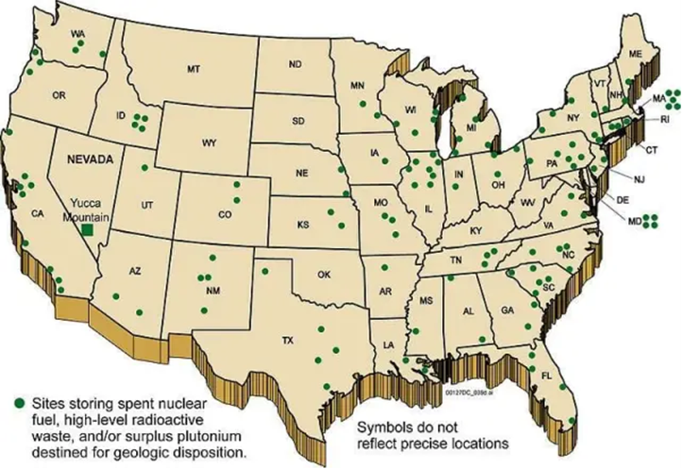
Waste Island
If TMI-1 operates for 20 years, central Pennsylvanians will be asked to baby sit and additional 600 tons of toxic trash with no
forwarding address. If the plant is granted a license extension than there will be 800 more tons of radioactive garbage marooned on an island that floods.

Slide 11
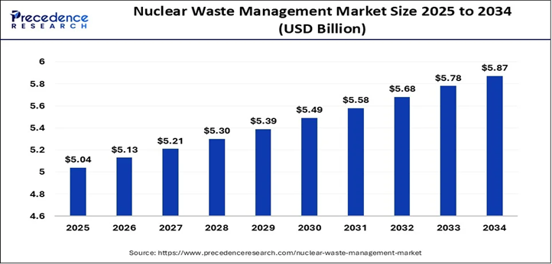
Constellation is in no hurry to remove the waste. There is a financial incentive to keep the waste on the island. The nuclear industry sued the Department of Energy for not completing
a waste site. Rather than invest in a solution and stop making the toxic stew, the DOE pays Constellation millions of dollars each year to keep the waste on Three Mile Island
Craig Nesbit, director of communications for Exelon, said the agreement with the DOE is open-ended. If the repository still isn't open by 2015, for example, payments to Exelon could exceed $600 million.

Slide 12
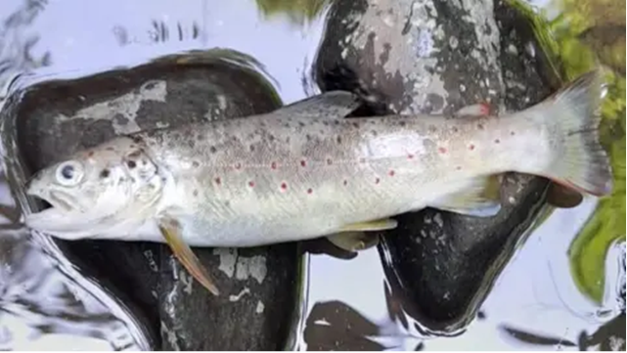
Air and Water Impact
What about nuclear power’s impact on air and water?
Nuclear power is water intensive and devastating to aquatic life. Effluent discharges and thermal pollution cause fish kills, wreak havoc on habitats, and tritium discharges have been a historic problem at TMI.

Slide 13
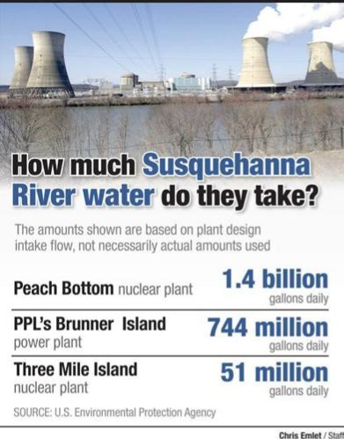
Water is a Limited Public Resource
Nuclear power plants use millions of gallons daily to cool their superheated reactor core. There are three nuclear generation stations on the Susquehanna River. Peach Bottom and TMI-1 are located on the Lower Susquehanna. Three Mile Island applied to withdraw up 72.3 million gallons of water per day.
We need to view water as a precious resource and limited commodity; not a nuclear subsidy.

Slide 14

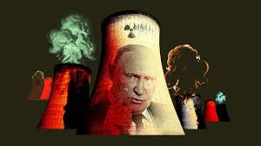
The production of nuclear power creates more terrorist targets, more dependency on Russian fuel, more toxic waste, but less safety, less security, and fewer resources to upgrade the PJM grid.
How does switching our fuel addition from OPEC to
Russian uranium makes us energy independent?

Slide 15
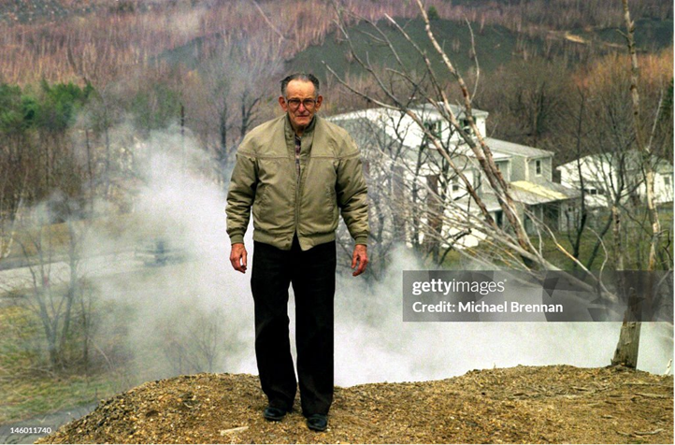
Nuclear First Pennsylvania Last
Nuclear energy is not the answer. We have a diverse energy portfolio in Pennsylvania, and we should refrain from putting our
thumb on the energy scale. Governor Shapiro is pressuring PJM to put TMI at the front of interconnection que.
Pennsylvania has excess capacity and exports 30% of its energy, but ranks 47th in renewable energy growth.

Slide 16
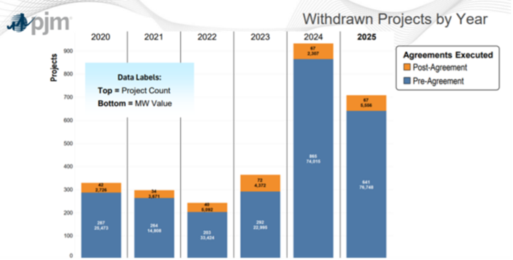
There are currently 268 gigawatts of energy waiting to be hooked up to the PJM grid. Solar and wind make up 95% of the clean energy waiting in line. Unfortunately, PJM has slow-walked interconnection reforms to connect these resources to the grid.

Slide 17
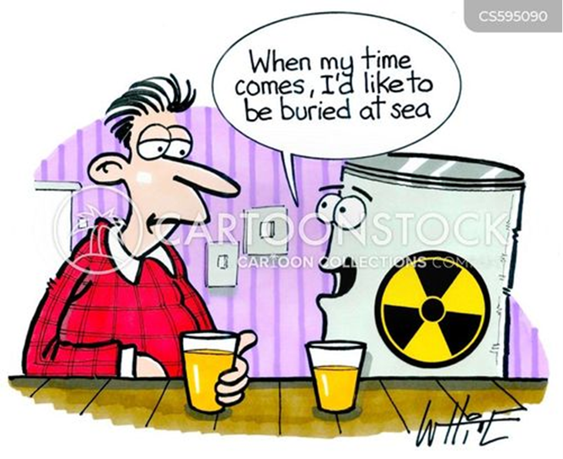
Take Out the TRASH
If nuclear power production is so safe and improved, why does the cleanup of Three Mile Island Unit-2 continue to vex the industry?
Here’s a thought: How about concentrating resources on cleaning up the mess you made 43 years ago.
If Bill Gates wants the power, let him take out the trash.

Slide 18
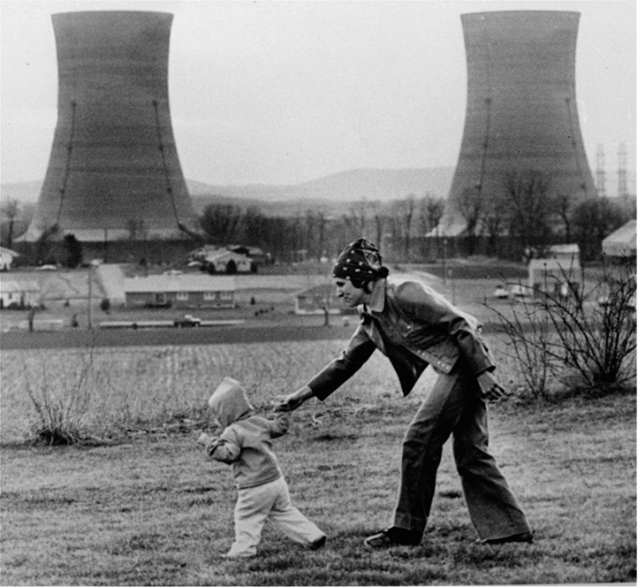
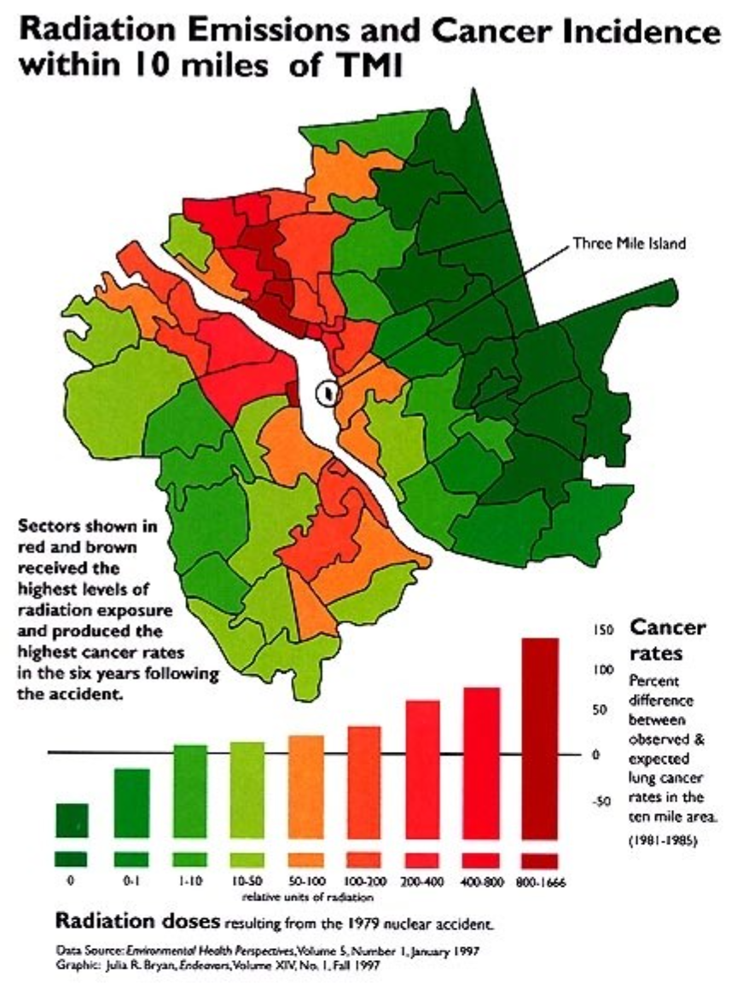
The accident at Three Mile Island is not over

Slide 19
Litigation Menu
Pennsylvania Department of Environmental Protection:
NDPDES Permit. Testimony filed; waiting for a decision.
Clean Water Quality Certification. Case was litigated for TMI-2; may have second life with TMI-1. The TMI-2 appeal was modeled on the Point Beach case and the need for an affirmative order. DEP and SRBC were silent on the CWA.
This case has moved to the DEP and is ripe for litigation
in the summer.

Slide 20
Federal Emergency Management Agency
Emergency Planning. Petition filed at the NRC, and this Contention is parked at the Atomic Safety & Licensing Board
Nuclear Regulatory Commission:
Fuel loading: We won a stay until this summer.
TMI-1’s LAR’s were submitted in February.
License “renewal” prompted “exemption” filing by TMIA. Introduced as a Contention and dismissed
Name change: We lost and the appeal was denied.

Slide 21
Steam Generator tube failure and “wet layups” will surface, but we don’t have the resources to litigate.
Susquehanna River Basin Commission.
Consumptive use and surface withdrawal for Amazon at Susquehanna was approved.
Consumptive use and surface withdrawal for Three Mile Island was submitted and not approved. The vote is in June.
Both initial applications had flaws and were rejected.

Slide 22
NRC and TMI-2 Response
Post-script: TMI-2 Cleanup to Be “Paused.”
NRC: “The NRC staﬀ requests that TMI-2 Solutions explain its strategy to eﬀectively reconstitute and train personnel needed to perform during active decommissioning after a three-year hiatus of active decommissioning.”
TMI-2 Solutions: “To add context to this request, consideration must be given to year-over-year Nuclear Decommissioning Trust Fund performance."

Slide 23
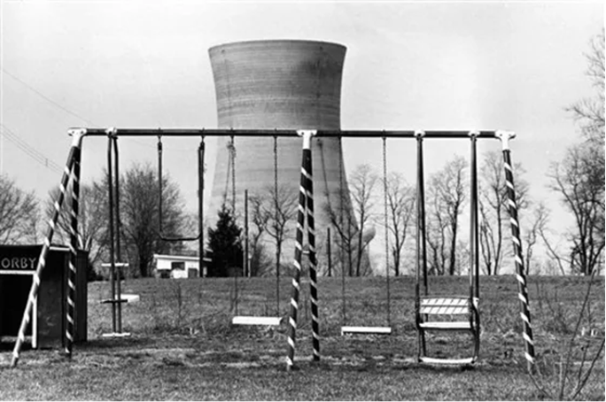
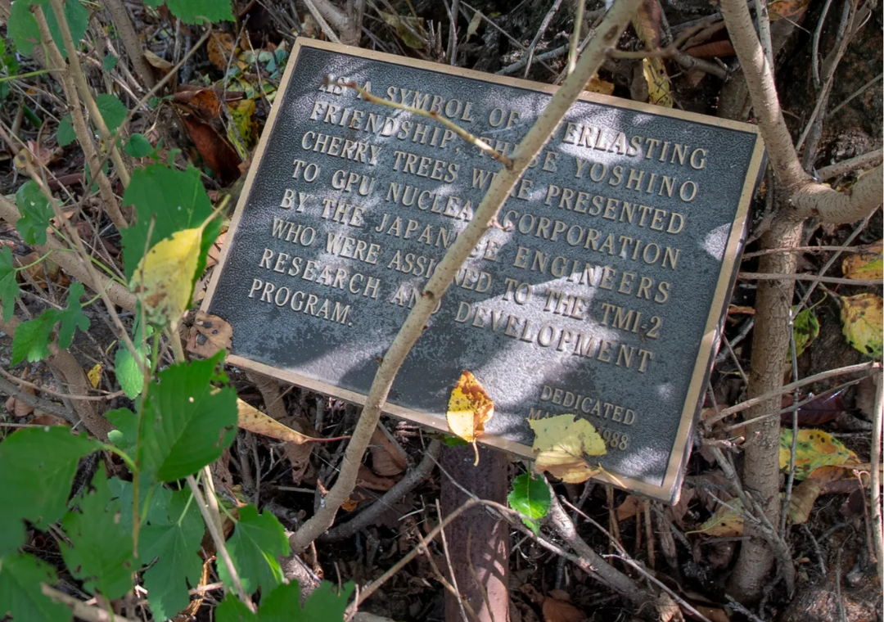
The Future Should Not Repeat Historical Mistakes

