Slide 1
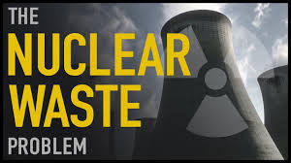
House Environmental Committee Testimony
Eric Epstein
Three Mile Island Alert

Slide 2
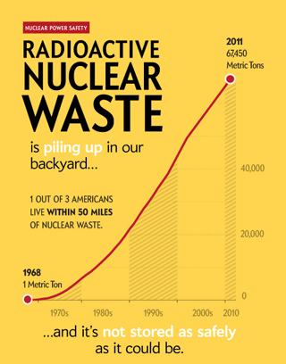
There is nothing clean or green about nuclear waste
High-level radioactive waste continues to accumulate at reactor sites where it is made.
There is no plan to permanently isolate it and safety issues with the current options

Slide 3
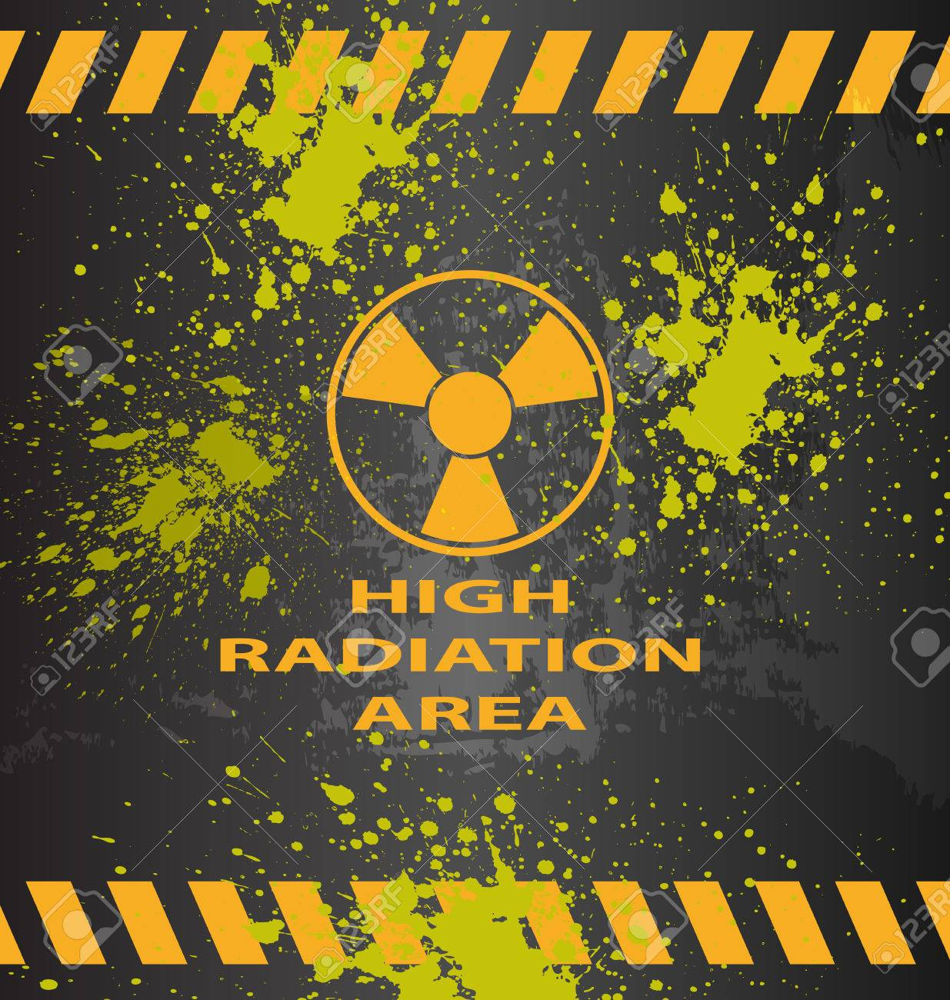
How much nuclear waste do we have?
As of 2018 there were 80,000 metric tons of uranium of commercial irradiated fuel in the US
2,000 metric tons of nuclear waste is generated every year
There is approximately 7,560 metric tons of high-level radioactive waste fuel stored at Pennsylvania’s nuclear power plants.

Slide 4
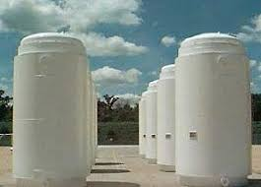
Dry Cask Storage
Beaver Valley, Limerick, Peach Bottom and Susquehanna have transitioned to dry cask storage but not all of their high-level waste is stored that way. This is better than spent fuel pools, but dry casks are vulnerable to failure and difficult to inspect.
TMI is the only plant not using dry cask storage, they are only using spent fuel pools and those pools have been re-racked three times. They are out of room in their pools and yet have failed to transition to dry cask storage and won’t do so until 2022 at the earliest.

Slide 5
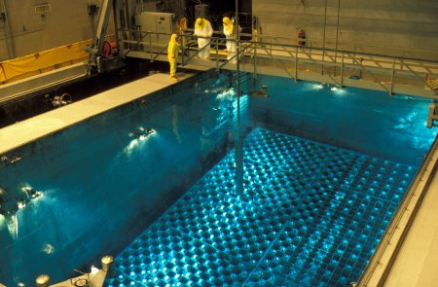
Reducing the amount of radioactive waste in fuel pools is a top priority!
Spent fuel pools, according to independent engineers, are the least safe way to store high level radioactive waste.
Dry storage is has risks, but it is a lot safer than spent fuel pools.
Again, TMI is currently only storing their waste in spent fuel pools.

Slide 6
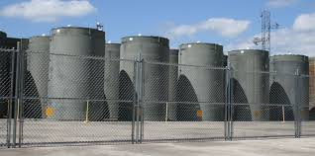
Hardened on-site storage (HOSS)
Hardened On-Site Storage (HOSS) is a better, safer way to store high level radioactive waste than spent fuel pools and dry cask storage.
HOSS provides better security at reactor sites with robust dry storage and community oversight, including real time monitoring of heat and radiation.

Slide 7
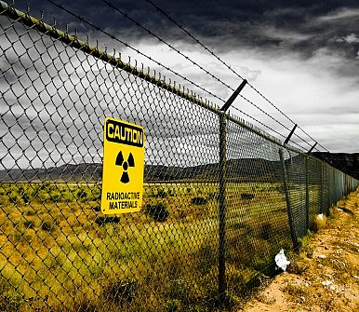
Are consolidated/centralized “interim” storage areas (CIS) the solution?
Consolidated Interim Storage (CIS) nuclear waste dumps would be sites to which high level nuclear power waste would be moved before being shipped to a CURRENTLY NONEXISTENT permanent repository.
Current federal law, Nuclear Waste Policy Act of 1982 and 1987 Amendments, state that CIS areas are only allowed if a permanent repository is operating. Moreover, the provision of the law allowing for a “temporary” site has expired, making any CIS facility ILLEGAL.

Slide 8
ILLEGAL CONSOLIDATED INTERIM STORAGE SITES (CIS) are being planned now
Despite the illegality of CIS areas, two private corporations applied to open such sites and the Nuclear Regulatory Commission (NRC) is proceeding with their applications. One is in Texas and the other is in New Mexico.
CIS areas are not designed to store irradiated nuclear fuel for the millions of years it remains radioactively dangerous
Failure to improve existing vulnerability of nuclear waste storage technology
It is likely that an “interim” site could become a de-facto permanent storage site if a morally and scientifically sound permanent system to isolate the waste is not developed

Slide 9
These corporations want to:
Legalize consolidated “interim” storage before there is a permanent repository
Shift liability for high level waste from nuclear power companies to the US Dept. of Energy aka US taxpayers
Raid Nuclear Waste Fund money collected for permanent isolation to be redirected for the so called “interim” storage.
These corporations want to change the law to allow them to make money while all liability is borne by the public

Slide 10
Recommendations for Pennsylvania
Recommendation 1: Reporting
Pennsylvania Licensees shall send the Pennsylvania Public Utility Commission (PUC) any report provided to the NRC within 10 days of the date upon which it was provided to the NRC.

Slide 11
Recommendations for Pennsylvania
Recommendation 2: Department of Energy
All spent fuel management costs recovered from DOE must be put into the Decommissioning Trust Fund and used only to pay decommissioning costs.

Slide 12
Recommendations for Pennsylvania
Recommendation 3: Parent Company Guarantee
The Licensee’s parent Company (not a LLC subsidiary) must provide a Parent Company Guarantee of not less than $500 million, after the payment of all taxes.

Slide 13
Recommendations for Pennsylvania
Recommendation 4: Spent Fuel Monitoring
Until all spent nuclear fuel has been moved into dry casks in the ISFSI, the licensee shall make annual payments to the Pennsylvania Department of Environmental Protection (DEP) and to the Pennsylvania Emergency Management Agency (PEMA) to defray the costs incurred by the Departments’ radiation control program for offsite and onsite radiological monitoring and testing.

Slide 14
Recommendations for Pennsylvania
Recommendation 5: Emergency Planning
Until the calendar year after all spent fuel has been moved into dry casks, the licensee shall make annual payments to DEP and PEMA and to each county within 10 miles of the nuclear site to defray costs incurred for providing emergency radiological planning. Licensees will continue to make annual payments to DEP, PEMA, the Commonwealth and each county within 10 miles of the reactor at a reduced level until all spent nuclear fuel has been removed from the site.

Slide 15
Recommendations for Pennsylvania
Recommendation 6: Monitoring fees and responsibilities
Consistent with Act 31, initial payment shall be $650,000. With respect to each subsequent calendar year, the payment shall be in an amount equal to the costs incurred in the prior calendar year by the department’s radiation control program. No decommissioning trust funds shall be used to make any of these payments.
Commonwealth personnel will accompany NRC personnel visiting the site in connection with any license termination plan, and to take and test samples.

Slide 16
Recommendations for Pennsylvania
Recommendation 7: Site Restoration
All activities conducted at this site shall comply with applicable federal, state and local environmental and human-health based laws, standards and regulations to the extent such laws, standards and regulations do not conflict with the standards identified in a MOU and should include the DRBC or SRBC as signatories. All subsurface voids shall be filled and the land shall be regarded and reseeded. All fill material must comply with the approved radiological and non-radiological remediation standards.
All hazardous waste shall be removed from the site to whatever level is required by federal, state and local laws or regulations for unrestricted use of the site.

Slide 17
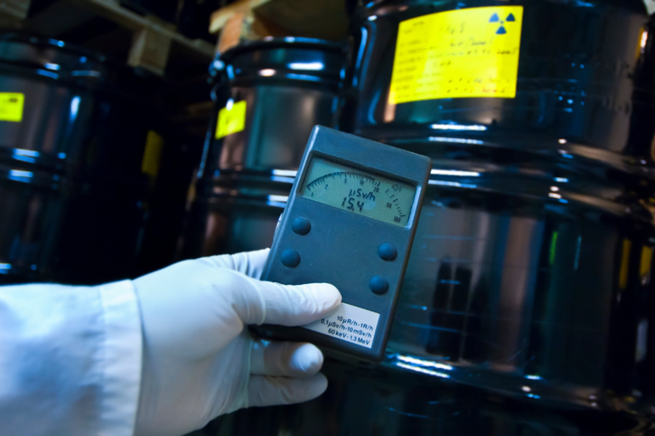
Recommendations for Pennsylvania
Recommendation 8: Radiation Monitoring
The BRP must continue offsite and onsite radiological monitoring until all spent nuclear fuel has been removed from the site. Licensees shall work cooperatively with DEP and PEMA to develop appropriate protocols related to non-radiological remediation and site restoration for information sharing, obtaining samples from onsite environmental media, conducting site visits and inspections, site characterization, remediation, site restoration and notifications. The licensee shall pay the costs as set forth above.

Slide 18
Recommendations for Pennsylvania
Recommendation 9: Offsite Emergency Planning
State and local (i.e., communities within 10 miles of the site) off-site radiological emergency planning must continue at its current level until all spent fuel is removed from the pool and placed in hardened dry casks, except that potassium iodide provisions may be eliminated 90 days after the reactor is de-fueled. Thereafter, it must continue at a reduced level until all spent nuclear fuel has been removed from the site. Licensees shall pay the cost of such monitoring as set forth above.

Slide 19
Recommendations for Pennsylvania
Recommendation 10: Spent Fuel Dry Cask and Pad Monitoring
Licensees agrees to monitor in real-time each cask for heat, helium and radiation, and provide real-time monitoring data to the Bureau of Radiation Protection The canisters and concrete outer packs are prone to cracking, exacerbated by corrosion. The Commonwealth shall have the ability to inspect the pad and casks and shall receive a copy of any report relating to any inspection of the pad or casks by the licensee or the NRC within ten days after the date of any such report.

Slide 20
Recommendations for Pennsylvania
Recommendation 11: ISFSI Security
To reduce the potential of a line-of-site attack, either the casks shall be stored in a building for additional security and environmental protection, or, at a minimum, a barrier not less than 5 feet higher than the height of any cask in the ISFSI shall be constructed around the ISFSI. While fuel remains onsite, security shall include: a protected area around the ISFSI, concrete vehicle barriers, lighting, cameras and intrusion detection equipment and cyber security measures.

