Slide 1
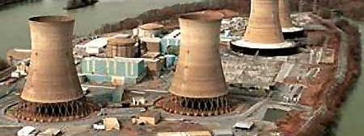
How Many Times Are We Going to Bail TMI Out?
March 6, 2019 Webinar
Eric Epstein of Three Mile Island Alert

Slide 2
Birthplace of atomic power Emotional attachment Industrial hub Nuclear power supplanted King Coal

Slide 3
1955: PSU: Breazeale reactor

Slide 4
1957: The Price-Anderson Act established a system of indemnification for legal liability resulting from a nuclear accident. Came into play on March 30, 1979

Slide 5
December 2, 1957: First commercial nuclear power plant - operated by the Navy - went into operation in Shippingport

Slide 6
1970s: Emergence of OPEC, gas lines, malaise and stagflation two recessions

Slide 7
TMI was built by hostage rate payers for $1.1 billion

Slide 8
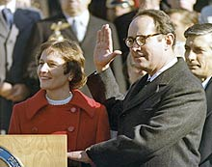
TMI-2 was bailed out and defueled in 1981-1993 at a cost of $987 million under the Thornburgh Plan

Slide 9
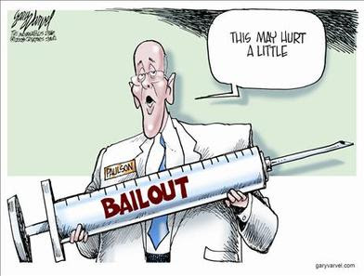
TMI was bailed out again in 1995 by ratepayers at a cost of $1 billion because there was no decommissioning fund at the time of the meltdown

Slide 10
And the bailout train stopped at TMI again as part of the $9 billion deregulation bailout from 1999- 2009.

Slide 11
PA rate payers spent over $9 billion dollars to restructure the whole electricity industry, which included bailing out uneconomic nuclear plants and other generators, when electricity rates were 15% above the national average

Slide 12
TMI is the most uneconomical reactor in the state, and lost more than $300 million dollars over the past five years despite the deregulation bailout

Slide 13
Now two nuclear corporations, Exelon based in Illinois and First Energy headquartered in Ohio, no longer believe in the Pennsylvania marketplace. These corporations want to charge consumers a nuclear tax, and ship the profits to Illinois and Ohio. Not the good neighbor policy most of us had in mind

Slide 14
Remember Three Mile Island?

Slide 15
TMI-1, the bailout candidate, became operational in 1974. Like most nuclear plants, it was behind schedule and over budget

Slide 16
Unit-2 came on line in 1978, and was also behind schedule and over budget. Hostage ratepayers paid $1.1 billion in 1970s dollars to build Three Mile Island

Slide 17
Then came the meltdown and the bailouts

Slide 18
Bailout #1
After 90 days of operation, TMI-2 melted down. Rate payers and tax payers came to the rescue. Under the Thornburgh Plan, TMI-2 received $987 million to defuel the melted core.
We protected TMI from bankruptcy, but Unit-2 remains a high-level radioactive waste site.

Slide 19
How did the owners show their gratitude?
TMI-2 pays no taxes
reduced their insurance coverage
decreased their cleanup staff from 1,500 in 1988 to the current level of “0.”
The defueling of TMI-2 actually employed three times the number of employees that Exelon has currently has on site

Slide 20
Bailout #2
In 1995 the Pennsylvania Supreme Court reversed a lower court’s decision, and allowed GPU to charge rate payers for the cleanup of the TMI-2 accident.
Yes, we got the cleanup bill, and receive no tax revenue for a plant that operated for 120 days

Slide 21
In case you had forgotten, the nuclear industry failed to establish cleanup funds for an accident they promised would not happen. The current cost to decommission TMI-2 - which will be totally underwritten by rate payers - was determined by the NRC to be $1.266 billion in 2018

Slide 22
Bailout #3
In 1996 the Pennsylvania legislature passed the Electricity Customer Choice and Competition Act. The law restructured the electric industry, separating the generation of electricity from its distribution and transmission.
Pennsylvanians were free to choose the source of their electricity, but ownership and operation of the utility wires remained with regulated monopolies

Slide 23
There was one huge problem – utilities were saddled with nuclear power plants that were burdened with enormous debt due to cost overruns. The rate payers bailed the nuclear industry out again

Slide 24
TMI-1 was part of the $9 billion deregulation bailout that took consumers a decade to pay off. Keep in mind, these payments were meant to help nuclear power generators transition to competitive markets

Slide 25
Three Mile Island is the intersection of corporate socialism and voodoo economics

Slide 26
I oppose yet another bailout for TMI. But…… They're baaaaack!

Slide 27
Three Mile Island is the most uneconomical reactor in the state. It’s also an old and small reactor that has operated beyond its 40 year license, and has cut its work force from 802 to 525 since 1999, but is home to 1,200 metric tons of high-level radioactive garbage

Slide 28
Profit by Plant
Pennsylvania is home to five nuclear plants, and four sites remain profitable.
Last year’s nuclear profits included:
Beaver Valley ($165 million)
Limerick ($193 million)
Peach Bottom ($150 million),
Susquehanna ($171 million.)

Slide 29
Why would we bail out an industry that made a combined profit last year of $679 million?

Slide 30
Bailout #4?
If consumers already paid to build Pennsylvania’s nuclear plants, and then paid off the debt on the nuclear plants, why does TMI need yet another bailout?

Slide 31
If the bailout in New Jersey cost $300 million a year, how much is the bailout going to cost Pennsylvania, which has three times the amount of nuclear capacity? About $1 billion a year

Slide 32
Wasn’t this the same industry who told us nuclear energy would be “too cheap to meter?”

Slide 33
There is a popular myth circulating that nuclear plants are “carbon free." The entire nuclear fuel cycle contributes to GHG levels and Carbon 14 is released during operation. In addition, nuclear plants routinely vent some of the deadliest gases known to exist; and multiple studies have shown increased health effects for those living near reactors

Slide 34
Running distressed nuclear reactors allows for the release of more carbon, making climate change worse than if the PUC reinvested or mandated energy efficiency increases for customers and Legislative support for renewable energy

Slide 35
US utilities pay an average of 2–3¢/kWh for efficiency programs; some are cheaper

Slide 36
The Nuclear Energy Institute’s data (the 2014–16 average) states that the average reactor in the top quartile of operating cost cost 5.2¢/kWh just to run; the second quartile, 4.1¢/kWh

Slide 37
That’s why nuclear is uncompetitive

Slide 38
So for every nuclear kWh not generated, the utility could instead buy several kWh of efficiency or renewable energy and displace more fossil-fueled generation. The first kWh of efficiency displaces what the nuclear output was doing; any additional efficiency bought can displace fossil-fueled generation

Slide 39
State-by-state analysis by UCS shows that where efficiency and renewables are allowed to compete with supply. It generally takes only a year or two for these fast- to-install, carbon-free resources to fill the gap left by abrupt nuclear retirements

Slide 40
The nuclear-carbon shell game only works if you ignore the environmental cost on the “front end” of nuclear power production. From the moment uranium is mined, milled, enriched, fabricated and transported it releases large quantities of airborne pollutants

Slide 41
Where are the ads? Why no commercials?

Slide 42
The “clean air myth” was demolished on May 13, 1999 when the Nuclear Energy Institute’s advertising campaign was deemed “misleading” by the National Advertising Division of the Better Business Bureau.

Slide 43
The specific ad in question was displayed in The Atlantic Monthly (December, 1998). The commercial featured a cute owl singing the praises of nuclear power. Hootie then thanked the NEI for clean air. The Business Bureau stated: “The process currently used to produce at least some, if not most, of the uranium enriched fuels that are necessary to power nuclear energy plants emits substantial amounts of environmentally harmful greenhouse gases.”

Slide 44
Nuclear power’s greenhouse gas “cure” claims must be examined by tracing its fuel cycle. It is clear that the production of nuclear electricity is not “clean”, “green” or “carbon free. ”

Slide 45
The nuclear bailout scheme punishes rate and tax payers, and rewards a fading industry instead. Nuclear plants discharge chemicals to the Commonwealth’s waterways every year and kill untold numbers of fish and aquatic life. The nuclear wastes which are created by nuclear reactors will require untold billions of dollars to safeguard for thousands of years to come

Slide 46
With those two facts in mind, nuclear energy can hardly be viewed as an emission free electrical generator

Slide 47
Investment in alternative energy, energy efficiency and renewable generation is increasing as production costs decline, reliability margins increase, and we continue to build a more diverse energy portfolio

Slide 48
Home grown Pennsylvania options create a desired localized electrical resiliency while nuclear plants go off- line in response to grid disturbances. Moreover, it is a resiliency that does not rely on foreign sources of nuclear fuel or oil

Slide 49
TMI-1 is a 44 year old plant using 1960s technology. In 1974, one of the the “best automobile purchases” was a Ford Pinto. “Consumer Guide” stated, “The car has not been involved in a serious callback campaign.” Four years later, 1.5 million Pintos were recalled, and the number of deaths attributed to fuel tank fires ranged from 27 - 180

Slide 50
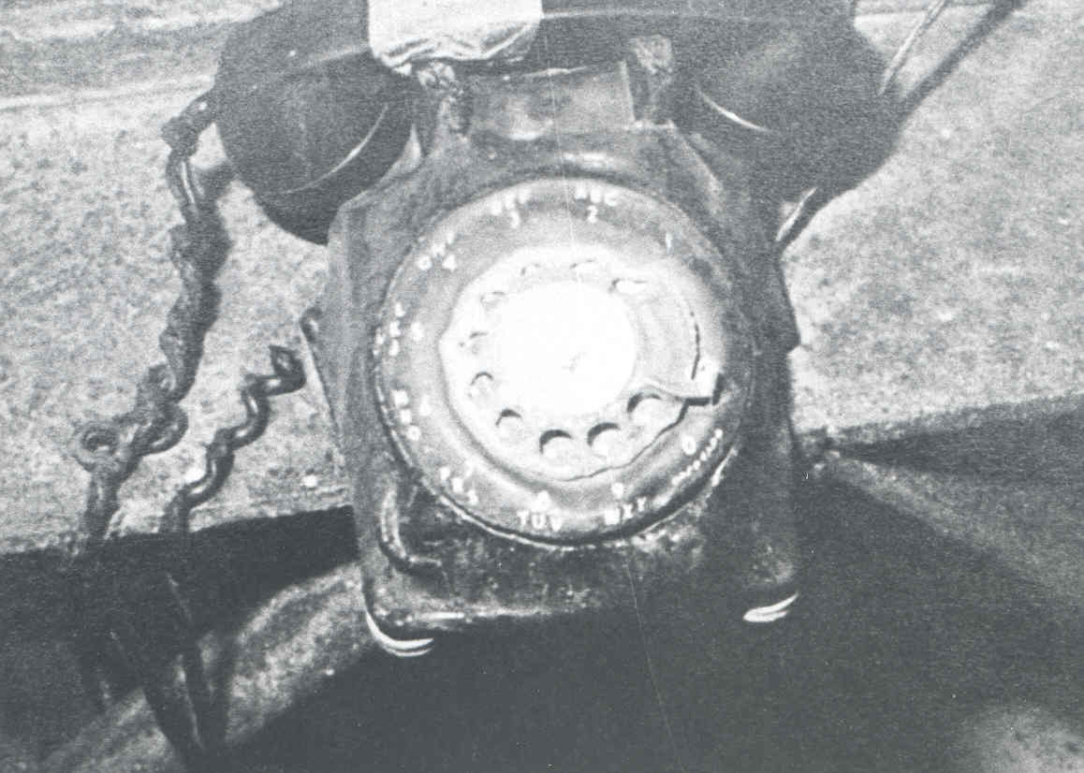
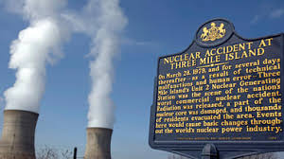
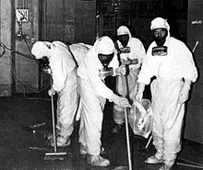
The same year the Pinto was rolled out, TMI-1 came on line. Nuclear technology was also viewed in high regard. Five years later, TMI’s sister reactor melted down after being on line for for less than 90 days

Slide 51
Everyone supports jobs, but at what price to hardworking taxpayers who have to support Exelon’s bottom line? In Illinois it was calculated that each job saved in Exelon’s latest bail out was over $1 million dollars per job. Just think about what those bail out dollars dedicated to RE/EE instead could do for Pennsylvania

Slide 52
Technology advances impact jobs. It happens in every industry. Car companies that have not increased their auto’s efficiency over 40 years are selling fewer cars than their competitors. Local telephone companies are selling people fewer land lines. The list goes on and on

Slide 53
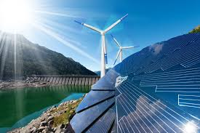
Why are we talking about retrofitting an Edsel when we can invest in clean, green and renewable technologies, energy efficiency and more progressive building and zoning standards?

Slide 54
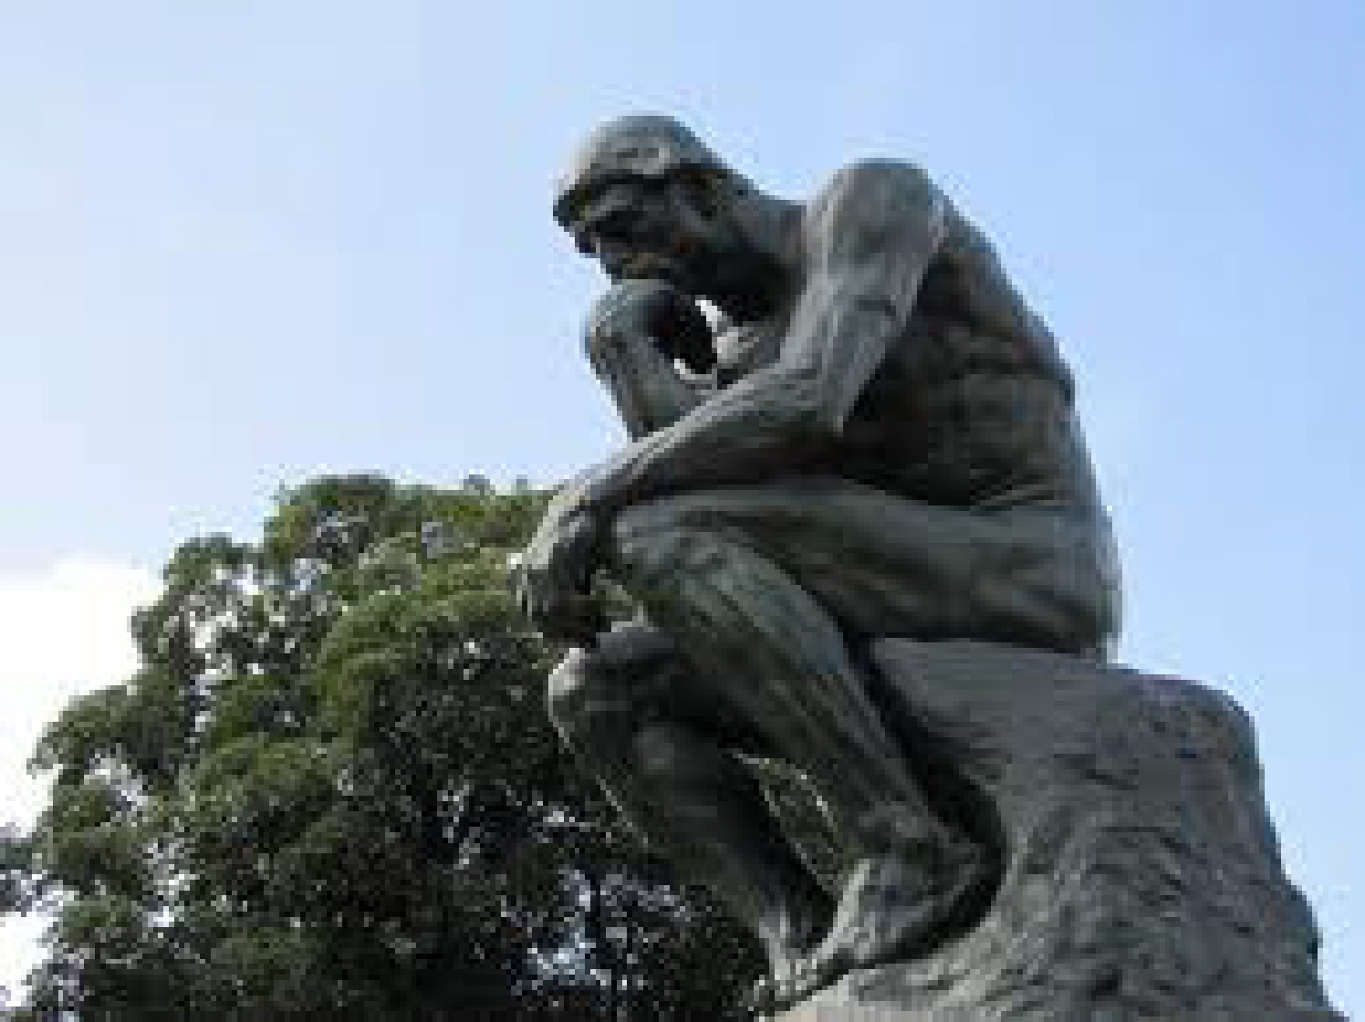
So why, if consumers already paid off the debt on the nuclear plants, does TMI need yet another bailout?
What happened to all the money collected from consumers under the Competitive Transition Charge over ten years?
How many more times are we going to bail out TMI?

Slide 55
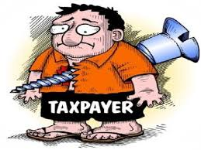
Here’s the cruel irony:
We never got the energy TMI generated. It went to eastern and western PA and New Jersey.
We got the risk. We got the radiation. We got the waste.
We never received an apology. But we got the bill, and 1,200 tons of radioactive garbage.

